Slide 1
E-Commerce Data Analysis Application
Contributions by Jerry Scott, Kolby Lingerfelt, Jodi Mitchell, Keren Sangalaza and Devene Gayle

Slide 2

Project Description
A Spark application.
This application will take in a generated CSV file of mock e-commerce data and will answer a series of analytical questions.
The processing of data uses Spark SQL.
Git and GitHub are used for version control management.

Slide 3

Tech Stack
The following technologies were implemented in our project:
Scala
Apache Spark
Spark SQL
Hadoop/HDFS
VSCode
Microsoft Excel
Google Sheets

Slide 4
E-Commerce Data Structure and Information
The structure for the data includes: OrderID, CustomerID, CustomerName, ProductID, ProductName, ProductCategory, PaymentType, Qty(Quantity), Price, DateTime, Country, City, WebsiteName, PaymentTransactionID, PaymentSuccessOrFailure, and PaymentFailureReason

Slide 5
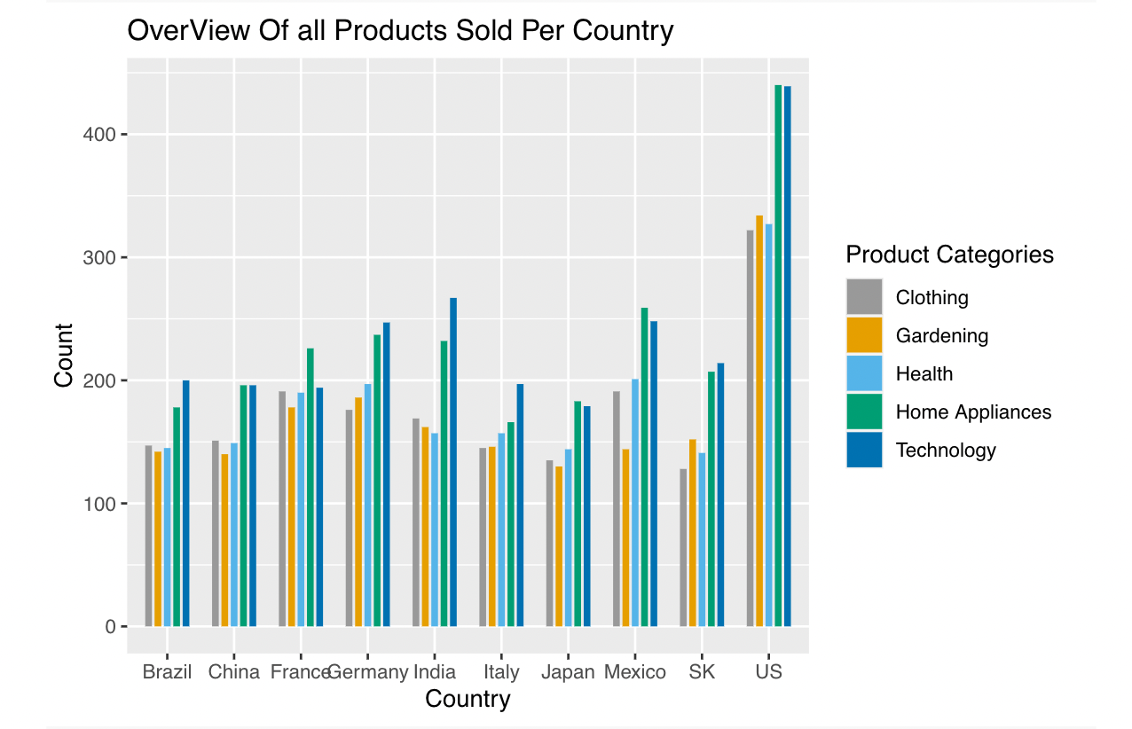
Analyzed Data:
Products Sold Per Country (PSPC)
Most PSPC:
Brazil - Technology
China - Home Apps / Tech
France - Home Appliances
Germany - Technology
India - Technology
Italy - Technology
Japan - Home Appliances
Mexico - Home Appliances
South Korea - Technology
United States - Home Appliances
Least PSPC:
Brazil - Gardening
China - Gardening
France - Gardening
Germany - Clothing
India - Health
Italy - Clothing
Japan - Gardening
Mexico - Gardening
South Korea - Clothing
United States - Clothing

Slide 6
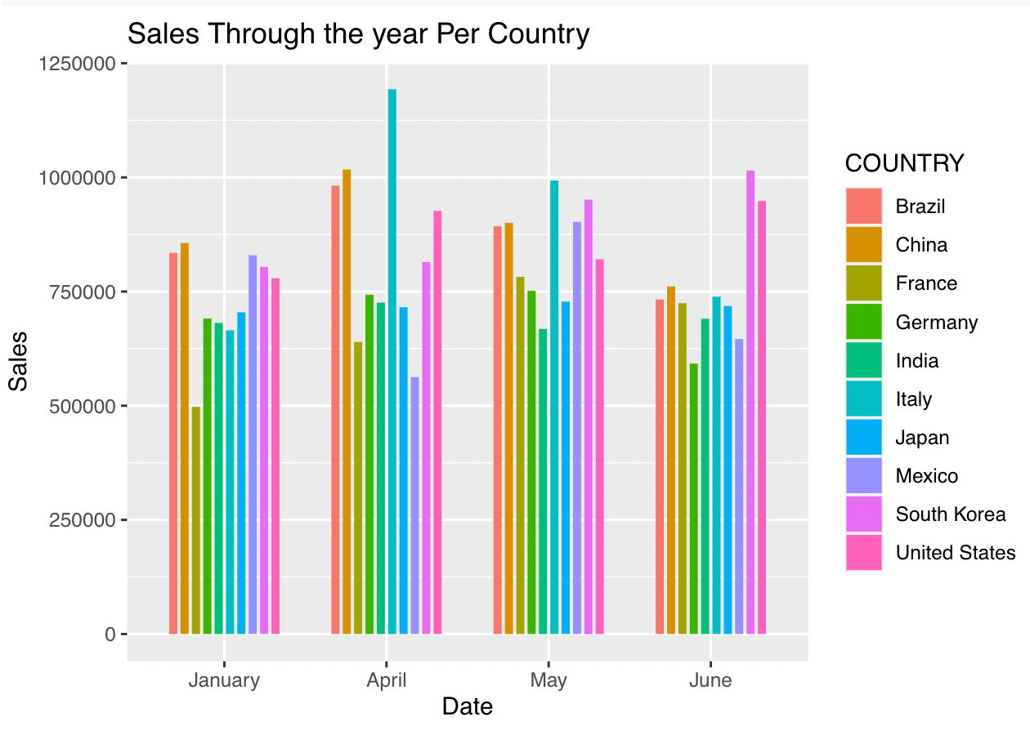
Analyzed Data:
Sales Per Country (January - June)

Slide 7
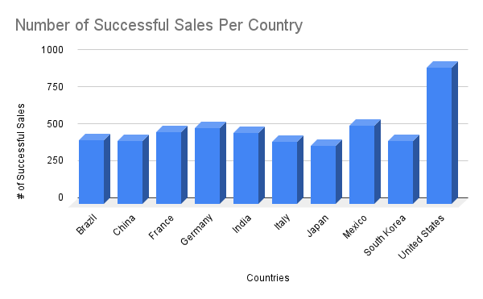
Analyzed Data:
Number of Successful Sales (Per Country)

Slide 8
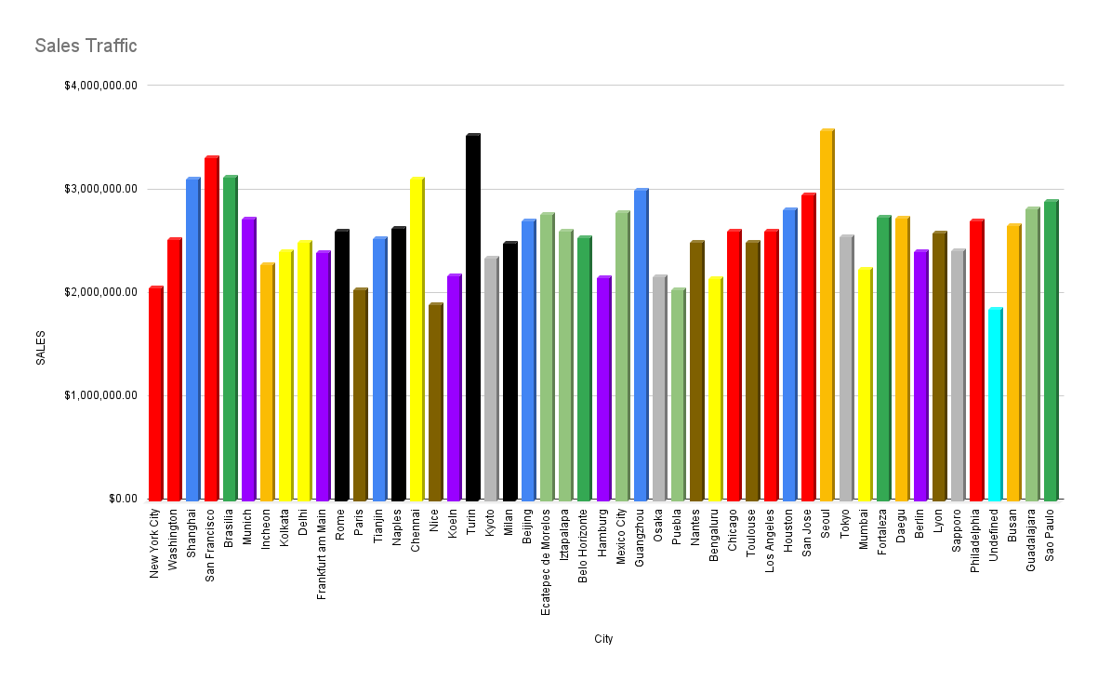
Analyzed Data:
Sales Traffic Per City (of All Given Data)
RED - United States; BLUE - China; DARK GREEN - Brazil; PURPLE - Germany; ORANGE - South Korea; BROWN - France; BLACK - Italy; GREY - Japan;
LIGHT GREEN - Mexico; YELLOW - India; TURQUOISE - Rogue Data

Slide 9
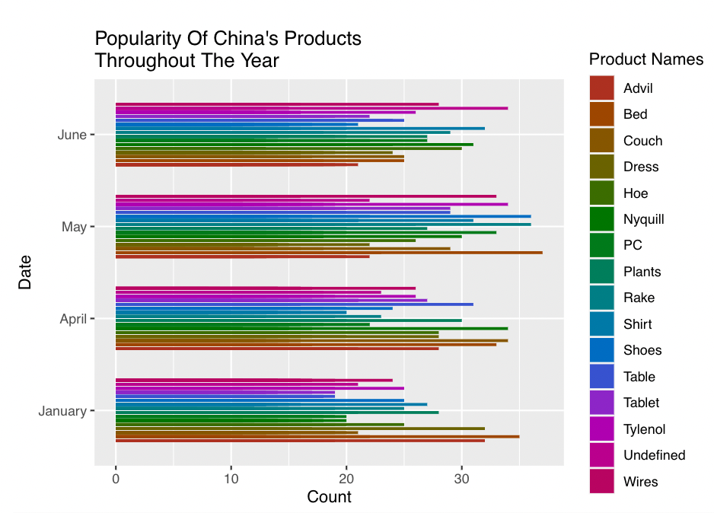
Analyzed Data:
Popularity of China’s Product Categories Over Time

Slide 10

Analyzed Data:
Popularity of Brazil’s Product Categories Over Time

Slide 11

Analyzed Data:
Popularity of France’s Product Categories Over Time

Slide 12

Analyzed Data:
Popularity of Germany’s Product Categories Over Time

Slide 13

Analyzed Data:
Popularity of India’s Product Categories Over Time

Slide 14
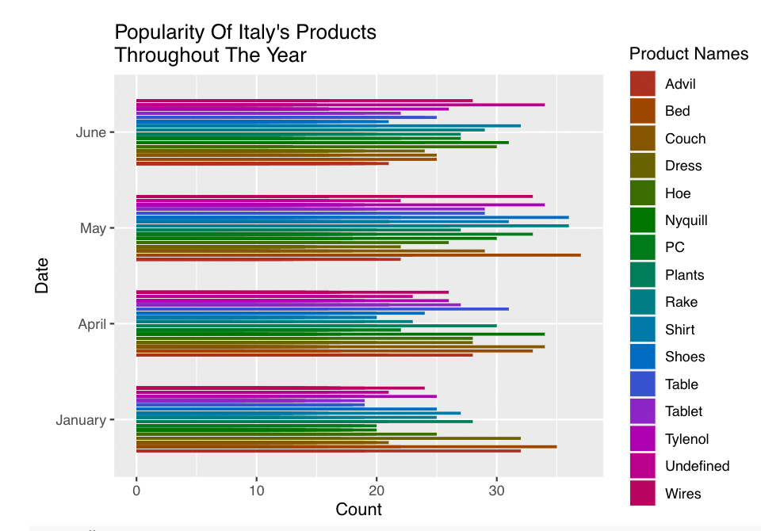
Analyzed Data:
Popularity of Italy’s Product Categories Over Time

Slide 15
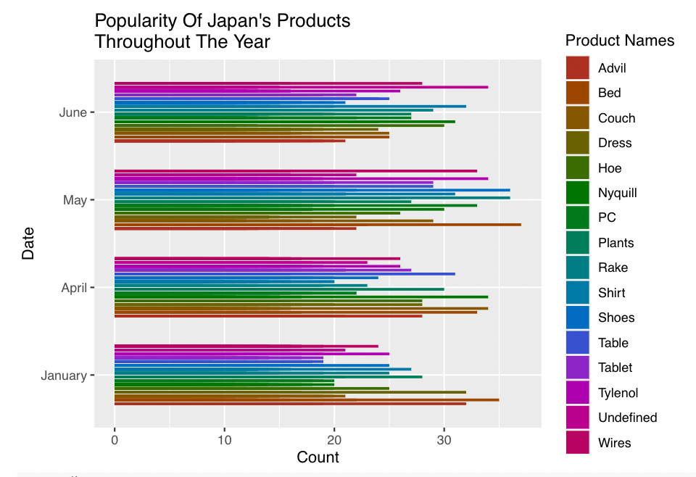
Analyzed Data:
Popularity of Japan’s Product Categories Over Time

Slide 16

Analyzed Data:
Popularity of Mexico’s Product Categories Over Time

Slide 17
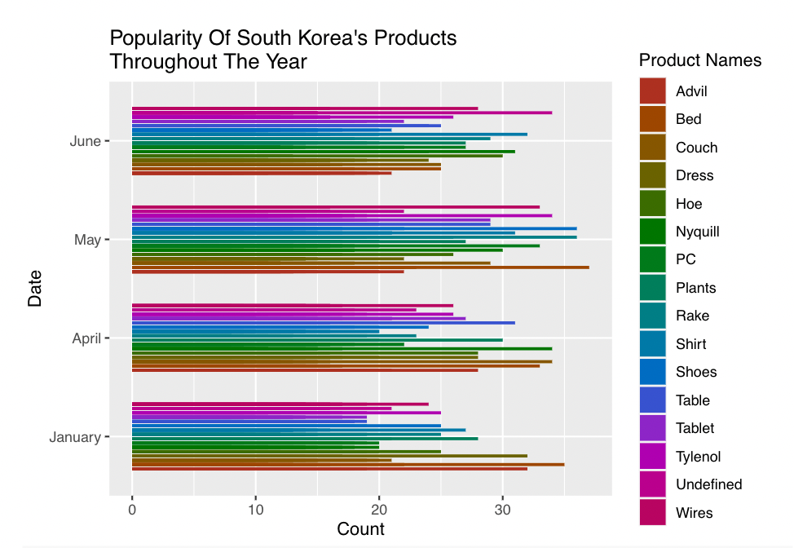
Analyzed Data:
Popularity of South Korea’s Product Categories Over Time

Slide 18
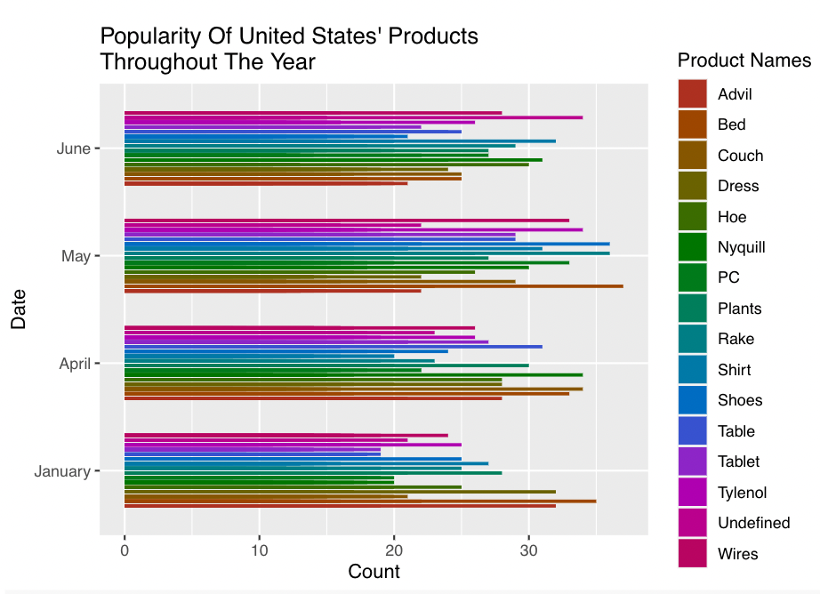
Analyzed Data:
Popularity of United State’s Product Categories Over Time

